Slide 1
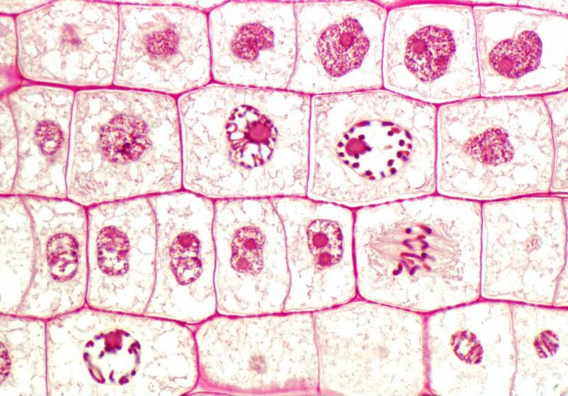
Cell Division in
the Onion Root Tip
(Lab 5)

Slide 2
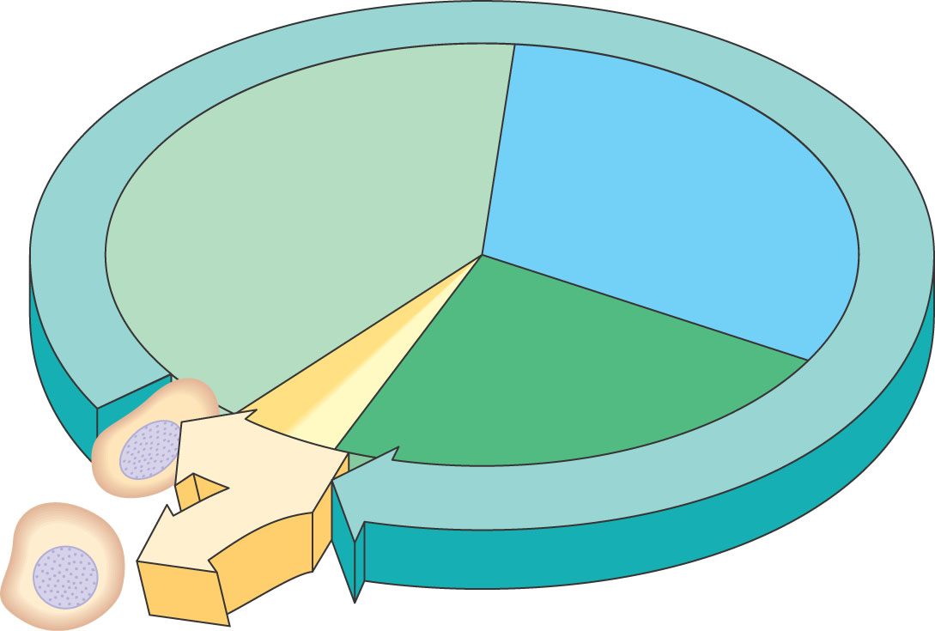
Phases of the Cell Cycle
The cell cycle consists of
Interphase – normal cell activity
cell division
INTERPHASE
S phase
(DNA synthesis)
Growth
G ₁
Growth
G₂
Cell Division

Slide 3
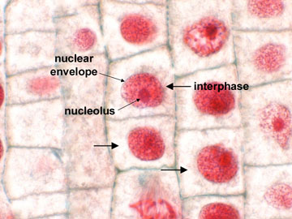
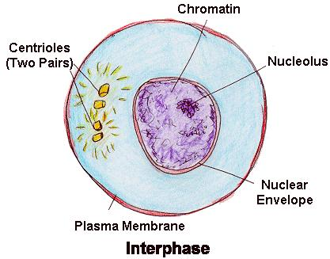
Interphase : It is a long, metabolically active phase between two successive mitotic cell division. Structural change:- 1- Extended and condensed threads of chromatin material. 2- Intact nucleolus 3- continuous nuclear envelope 4- the cytoplasm of the cell consist of two pairs of centrioles, from which rays of microtubes extend to form a structure called asters, leads to formation of mitotic spindle fibers.
Interphase

Slide 4
The human cells are replicated by two processes : nuclear division ( mitosis or meiosis ) and cytoplasmic division ( cytokinesis).
The Cell Division
Mitosis
The body cells divide for growth, repair and renew the body tissue.
Cytokinesis
Meiosis
The germ cells divide to produce gametes for reproduction
Cytokinesis

Slide 5
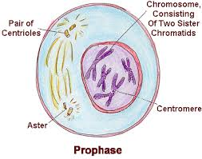
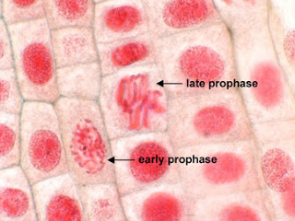
It is the longest phase. During this phase the Chromosomes condense and thicken, each duplicated chromosome appear as two identical sister chromatids • The centrioles move to the opposite sides of the cell to creat the mitotic spindle fibers • Nucleolus and Nuclear membrane disintegrate and disappear
The stages of mitosis
Prophase

Slide 6
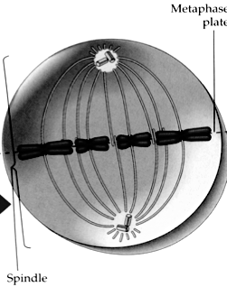
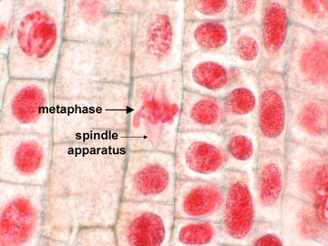
During metaphase the following changes take place:- 1- shortening and arrangement of the chromosomes in the middle part of the cell, in an area called equatorial plate( quarter) or metaphase plate. 2- Attachment of microtubules of the spindle fibers to the poles of the cell on one side and to the centromere of the chromosomes on the other side. The point of attachment between the microtubules and the centromere is known as kinetochore.
Metaphase

Slide 7
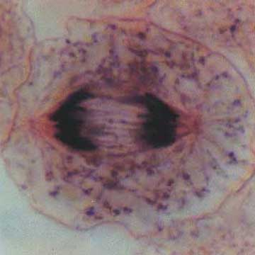
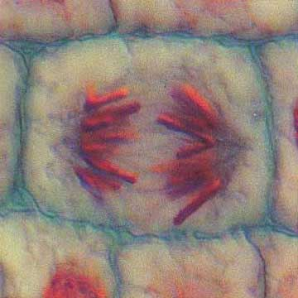
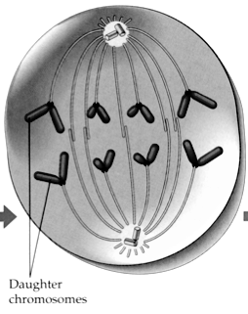
1- Splitting the centromeres of the chromosomes and separating the chromatin from each other to form the daughter chromosomes, the newly formed chromosomes move to the opposite sides of the cell . 2- shortening of the mitotic spindle fibers.
Anaphase
Animal Cell
Plant Cell

Slide 8
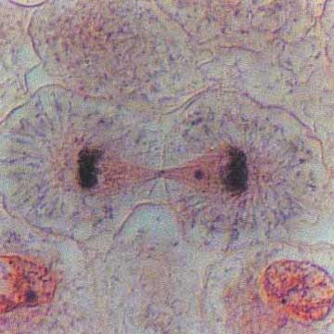
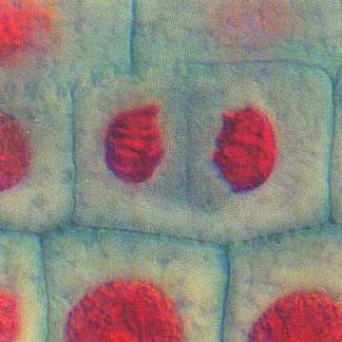
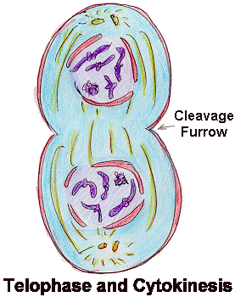
1- Extension of the chromosomes of the daughter cells to become less visible due to decondensation of their molecules to become chromatin material. 2- Nucleolus and nuclear membrane reappears 3- The spindle fibers disappear 4-Finally appearing of a contractile ring in the cleavage groove of the cell to assist in constriction of the plasma membrane during cytokinesis process.
Telophase
Animal Cell
Plant Cell

Slide 9
Material 1- Onions root tips 2- Microscope 3- Microscope slides and cover slips 4- Toluidine blue or aceto-orcein 5- 1M hydrochloric acid 6- Distilled Water
Examining root tip cells

Slide 10
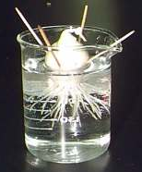
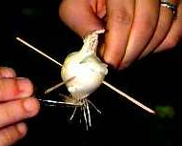
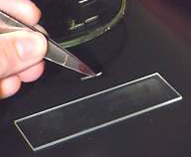
Procedure
Submerge the base of an onion in water at a constant temperature to grown roots for 48 hours.
Obtain an onion root and cut off the bottom 1 or 2 mm of the root tip and place it on a Slide.
Add a very small drop of 1M HCL acid to the root tip on the slide and let it sit for 4 min.
Using a paper to soak the HCL away from the root tip.
Cover the root tip with a drop staining solution and let stand for 2 minutes.

Slide 11
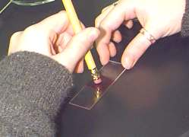
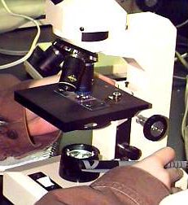
Procedure
Remove excess stain. Add one drop of water and gently lay a cover slip over the root tip.
Using a pencil eraser, carefully apply pressure to the cover slip area to squash and spread the root tip tissue.
Use the low power objective on your microscope to look for thin layers of cells and then use the 40X power objective to observe mitotic stages in individual cells.
Identify chromosomes at the various stages of mitosis in the water treated root tips. Make sketches of the stages observed.

Slide 12
